Slide 1
BUET ALUMNI PORTAL
Language: Python 3.7
Framework: Django 3.1
Database : Oracle 11g
Sheikh Saifur Rahman 1705008
Zaber Ibn Abdul Hakim 1705015

Slide 2
What is BUET Alumni Portal?
Different department of BUET has a very rich number of Alumni who are working at different parts of the world. They are open to help their juniors at different stage of thier university life and career. As they have already gone through these stages, their experience provides the students and junior with a lot of help and overcome a lot of difficulty.
Most of the famous university worldwide have very rich network among their alumni and students and they help each other out. Unluckily, being one of the top university of Bangladesh BUET has rarely any connection among their Alumni and students. Our idea of BUET Alumni Portal is to close the gap.

Slide 3
What does BUET Alumni Portal Offer?
Every student and Alumni will have their free account.
Everyone will have access to different resources of the portal according to their status like current students, alumni, faculty.
Anyone can ask others to help him out in Help Section.
Anyone can publish his research work and ask others to collaborate.
Users can post job offers for others to help them find their job.
Everyone can write different educative post to guide others in different area.
Anyone can arrange workshop , reunion events.

Slide 4
Let's dive deep and discover each section ...

Slide 5
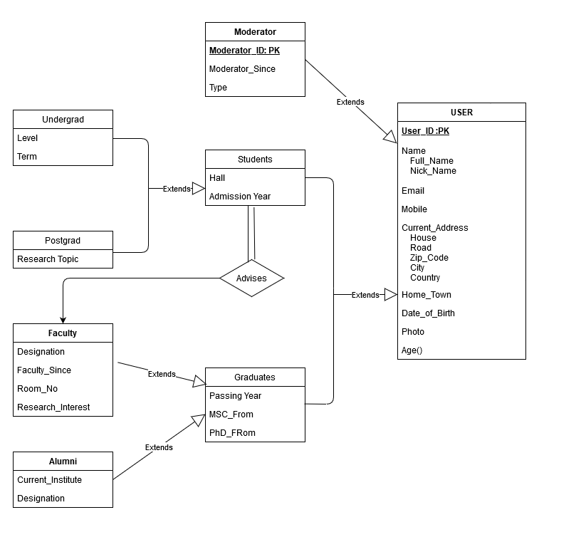
Let's start with the most important one, Users...
Users are divided into Moderator, Students & Graduates.
Moderators manages all the activity of the portal like maintaining discipline, approving posts and events, trace unusual activities etc.
Students are currently enrolled students. They are further divided into Undergrad and postgrad.
Again Graduates and divided into faculty and alumni. These entities are overlapping.

Slide 6
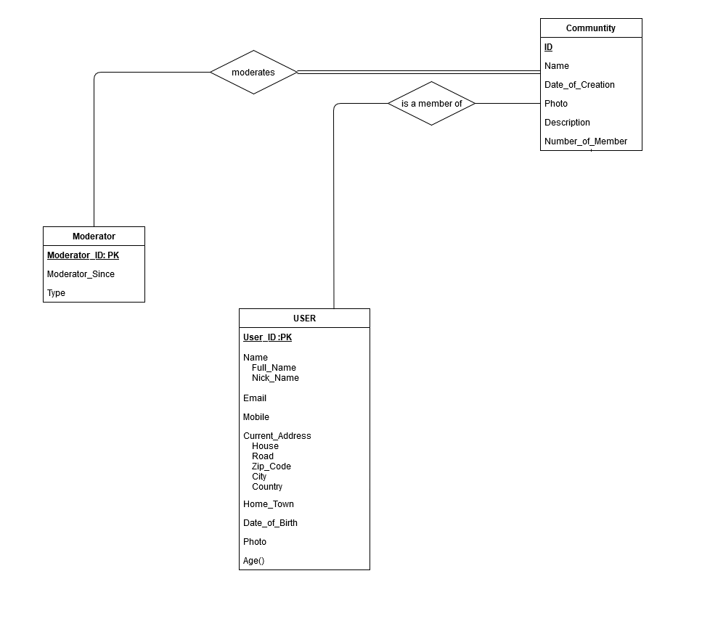
And the next one is Community
Communities are formed by set of users having common beliefs or interests.
There will be different communities for Undergrad, Postgrad, Faculty, Alumni of different regions and different institute.
A community will have some moderators who maintain all the activity of the community.

Slide 7
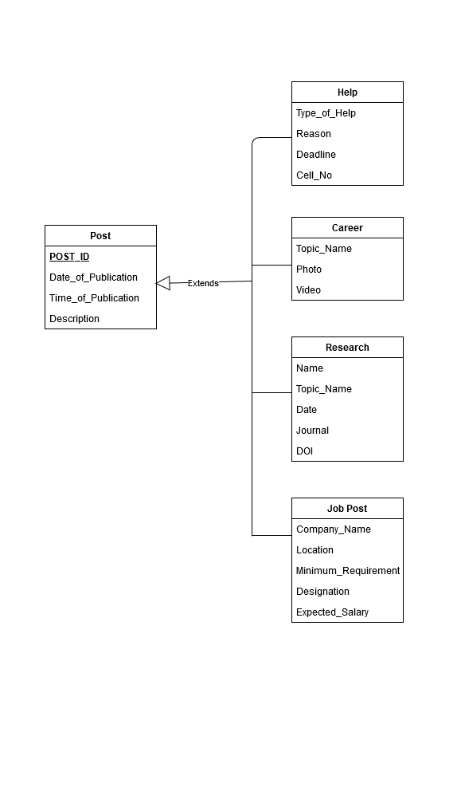
Post
Posts are the way of communicating with each other in our portal.
There are general posts and community posts. Community posts can only be interacted by the members of that community, whereas everyone can access general posts.
Users can post to get help from other users.
Different educational ,informative posts can also be posted.
Researchers can let others know about their research works and can ask people to collaborate.
Users can also post job offers to hire other alumni and current students.
Users can reply in response of a post.

Slide 8
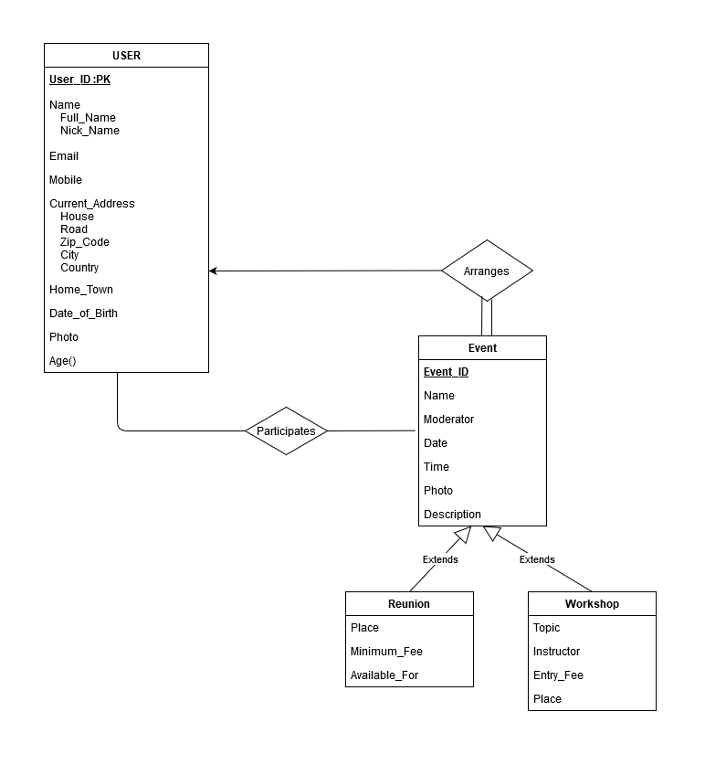
Finally, we have Events.
Events are of two types. Reunion and Workshop
Any user can inaugurate an Event. Anyone users can participate in general an event.
Restricted events for special groups like batch reunion can also be organized.
Users can organize Workshop for informing users about their research works or education workshops can also be organized.

Slide 9
Putting it altogether into ERD becomes ...

Slide 10
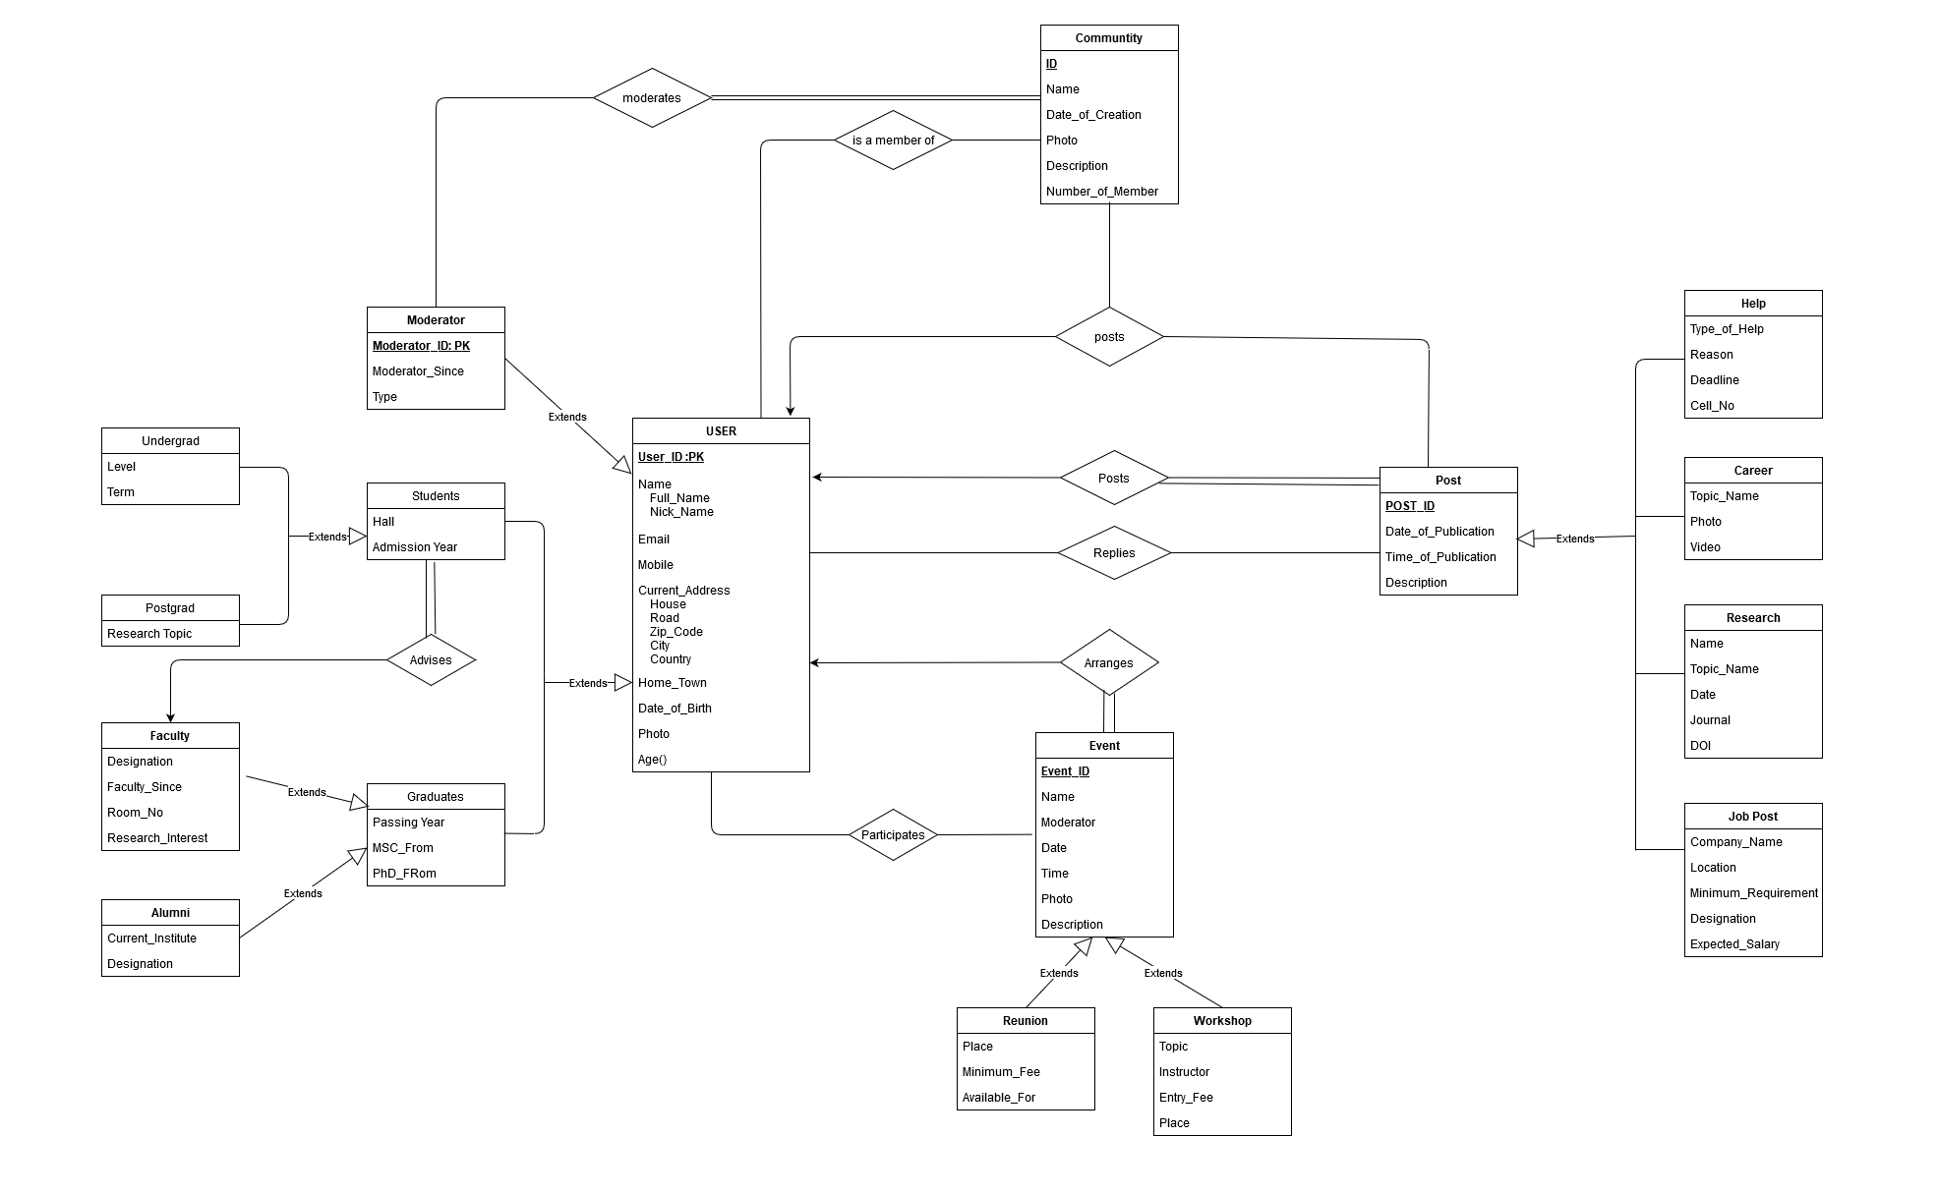

Slide 11
References:
MIT Alumni Association (https://alum.mit.edu/)
Alumni of University of Cambridge (https://www.alumni.cam.ac.uk/)
For any query, Please feel free to ask.

